Slide 1


Slide 2
Welcome!

Slide 3
Who we are
Women Who Code is a global non-profit dedicated to INSPIRING women to EXCEL in technology careers. We provide an AVENUE into tech, empower women with skills needed for professional ADVANCEMENT, and provide environments where NETWORKING and MENTORSHIP are valued.

Slide 4
What we do
To date we have held more than 700 events globally for 12,000 members spanning 14 countries and we are growing by 1,000 women per month.

Slide 5
Key Initiatives
Free technical study groups (Ruby, Javascript, iOS, Android, Python, Algorithms, Data Science)
Events featuring influential tech industry experts and investors
Career and leadership development
Encouraging women to be more involved in the tech community
Increasing # of female speakers and judges at conferences and hackathons
Hacknights

Slide 6

Where we are!
USA – Atlanta, Austin, Boston, Boulder/Denver, Connecticut, Dallas, Los Angeles, San Francisco, Seattle, Tampa, Wichita, Reno/Tahoe, New York City, Washington DC, Chicago
Canada – Waterloo, Toronto
United Kingdom – Belfast, London
India – Bangalore
Chile – Santiago
Brazil – Recife, Campa Grande, Recife
Jamaica – Kingston
Australia – Sydney
China -- Hong Kong
Mexico -- Colima
Germany - Frankfurt am Main
Japan - Tokyo
Uruguay - Montevideo

Slide 7
Word from our HOST
Notes:
Here the hosting company says something about themselves

Slide 8
iOS Bootcamp Goal
Make apps for iPhone, iPod Touch, iPad
Learning Objective-C and Cocoa Touch comes with creating your first iPhone native applications.
Improve your knowledge on object oriented programming and software engineering as well.
Learn generalized ideas on mobile application development.

Slide 9
Software & Hardware Requirements
Intel-based Macintosh, running Mac OS X 10.7 (Lion)
You do not need a device (iPhone, iPad, iPod touch): we will use the Simulators
Download Xcode: https://itunes.apple.com/us/app/xcode/id497799835?mt=12&ign-mpt=uo%3D8

Slide 10
Books and other resources
Apple documentation (Free!)
RayWenderlich - web Tutorials, iOS 7 By Tutorials, Objective-C
The Big Nerd Ranch Guide - iOS Programming, Objective-C Programming

Slide 11
Bootcamp Schedule
Basics of Cocoa, Xcode, Interface Builder, Storyboards, UIKit (UIButton, UITextField, UIImageView etc)
Demo: Hello World app, Learn Alphabets app
Homework: Silver Challenge - Learn all alphabet with sound.
Basics of Objective-C, UINavigationBar with UITabbar, Memory Management
Demo: Tab bar Project - Enhance the Learn Alphabets app
Homework: to improve on that project. Add silver points.
TableView, Delegates, MVC
Demo: Todo list project., or use tableviews in the Learn Alphabets app
Homework: Improve on the project. Add gold points on the project.
Advanced TableView OR Gesture Recognition
Demo: Swipe left to delete the row, swipe right to add a row (try on previous project!)
Homework: Sky is the limit :)

Slide 12
Cocoa and Objective-C Background
Cocoa Touch is the programming framework driving user interaction on iOS.
provides multi-touch, buttons, table lists, page transitions, collection view and gestures on the iPhone
Built upon the Model-View-Controller paradigm
When combined with the Interface Builder tool, it is both easy and fun to use drag-and-drop to design the next great iOS application.
Developed in 1980s. And selected as the main language used by NeXT for its NeXTSTEP operating system, from which OS X and iOS are derived

Slide 13
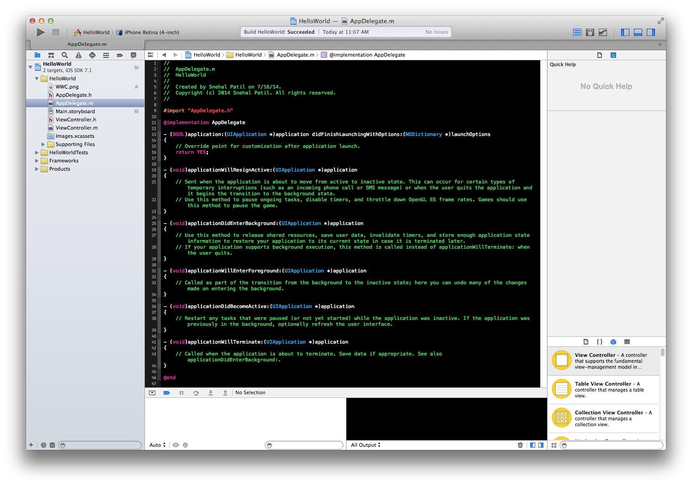
XCode

Slide 14
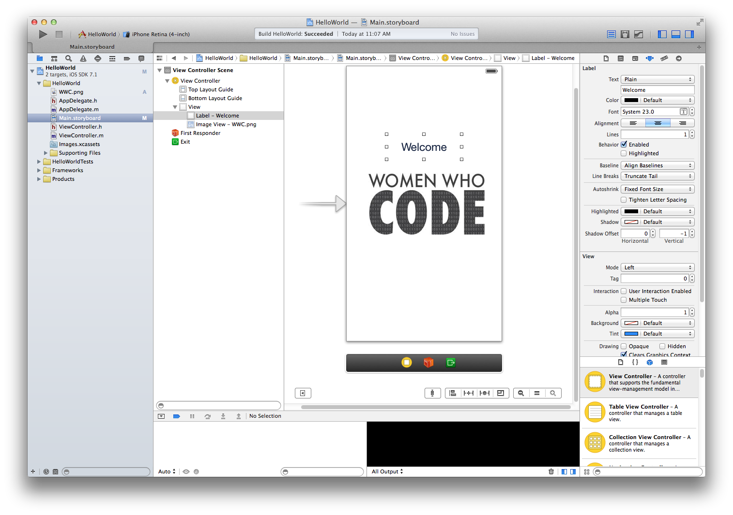
Interface Builder - Add a image

Slide 15
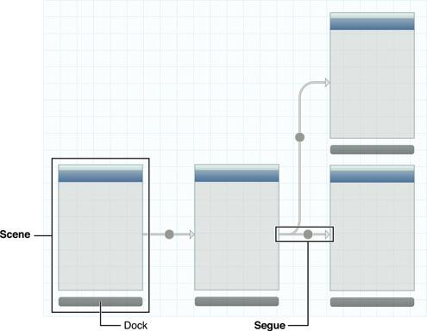
Storyboard
Visual representation of the of views and flow of iOS on one canvas.
Shows screens of content and the connections between those screens using segue
Editor allows you to add buttons, labels, table views, and text views onto scenes.

Slide 16
Demo
Welcome to WWC Bootcamp app.

Slide 17
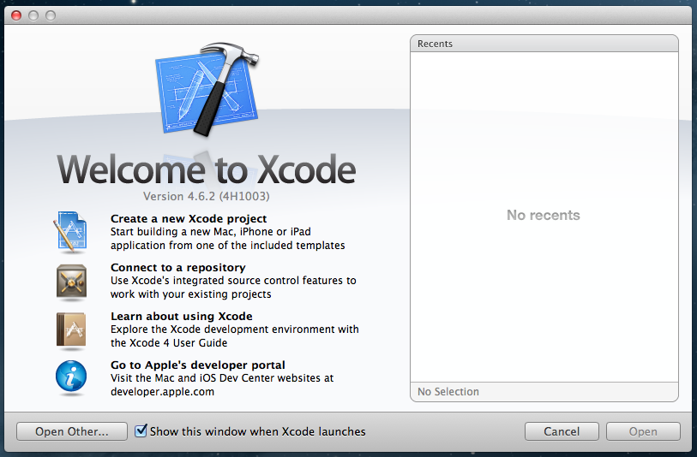
Welcome to Xcode

Slide 18
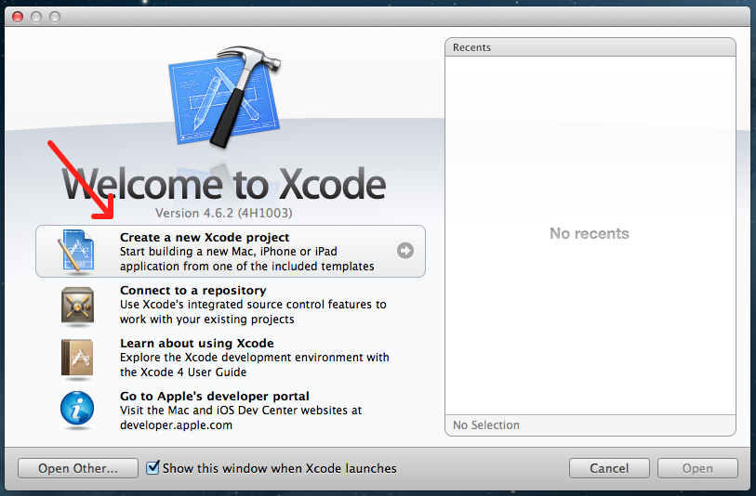
Select New Project

Slide 19
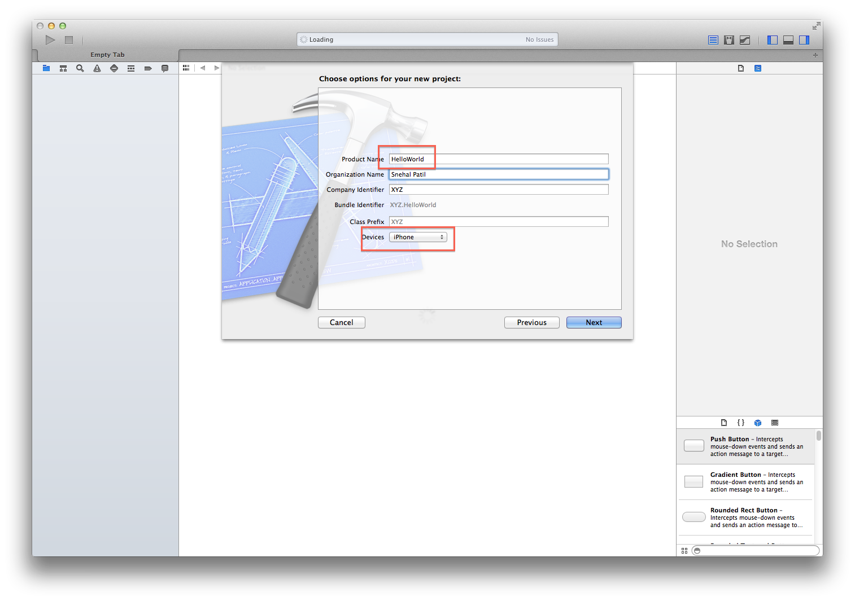
Name your Project

Slide 20
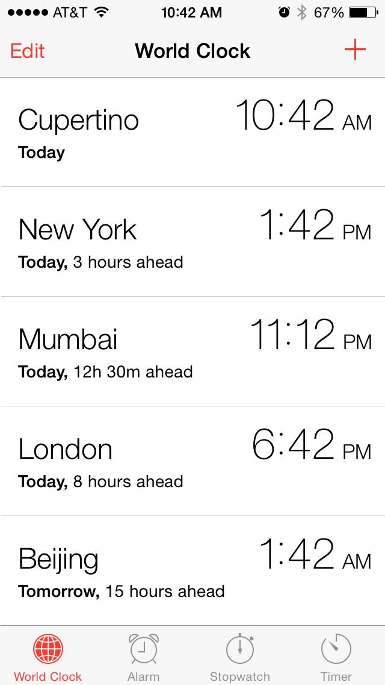
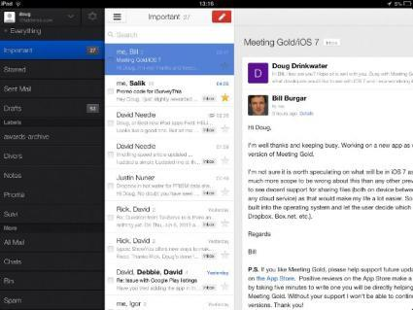
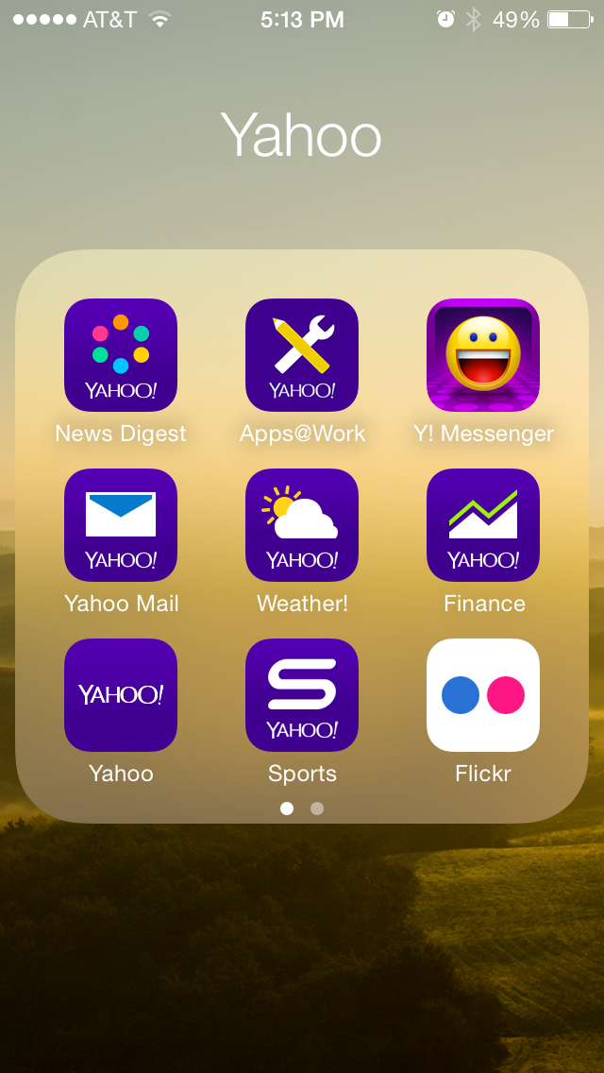
Project Template Samples

Slide 21
Choose Project Template

Slide 22
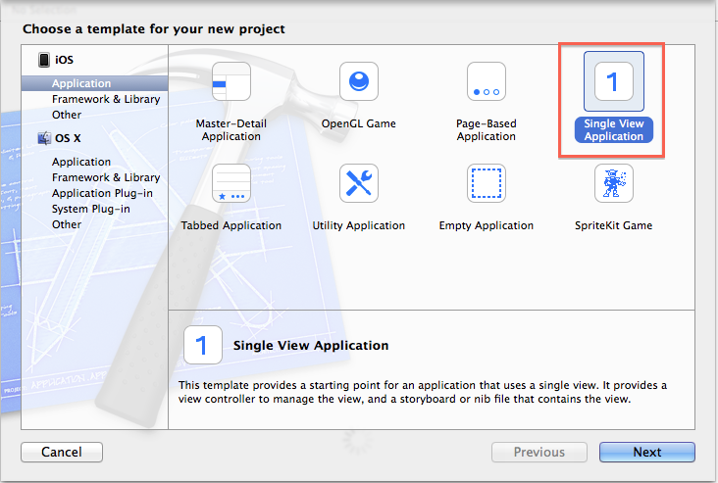
Single View Application

Slide 23
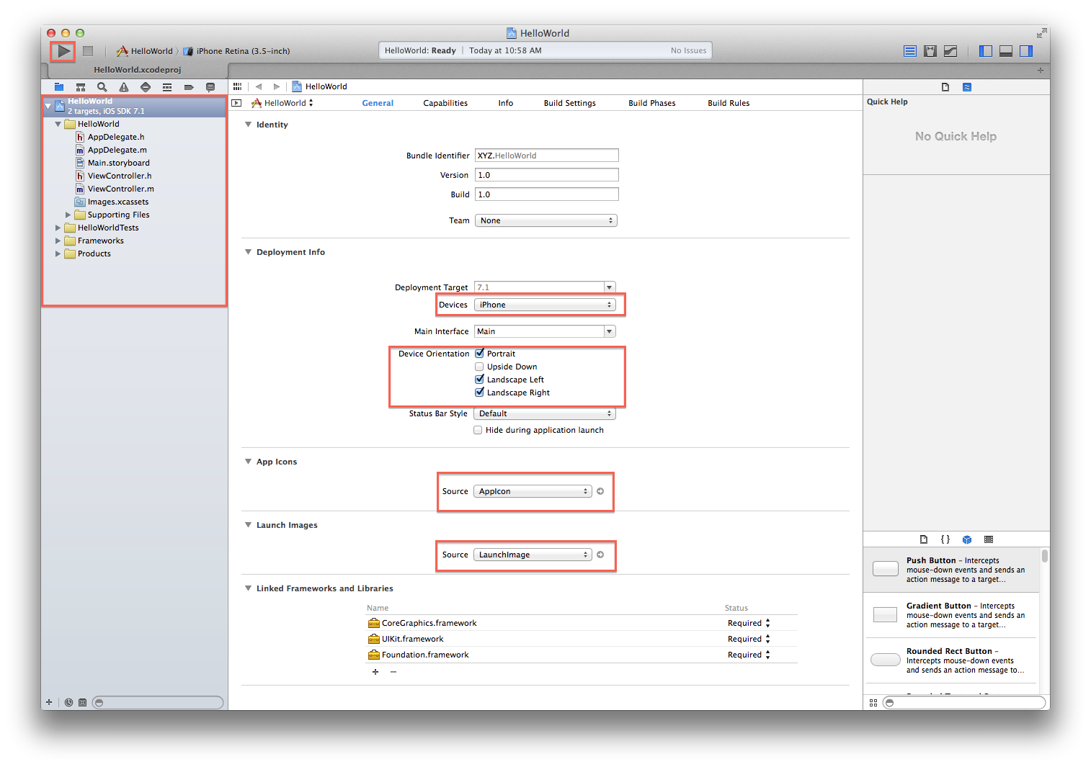
First Look of your project

Slide 24
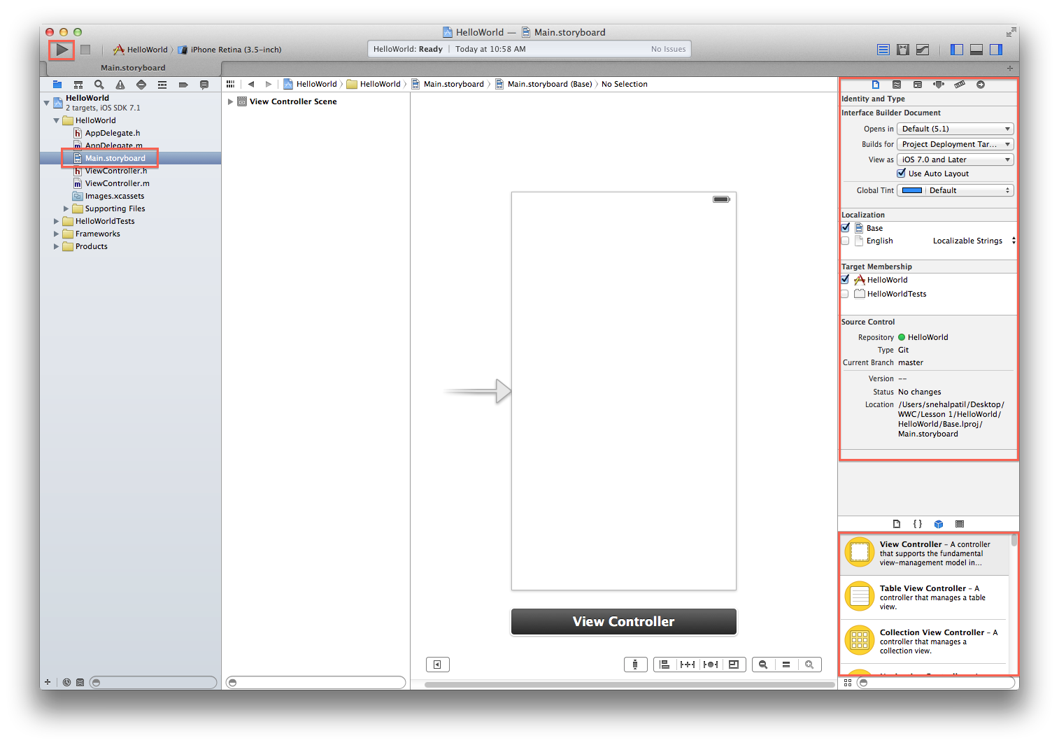
Main.Storyboard

Slide 25
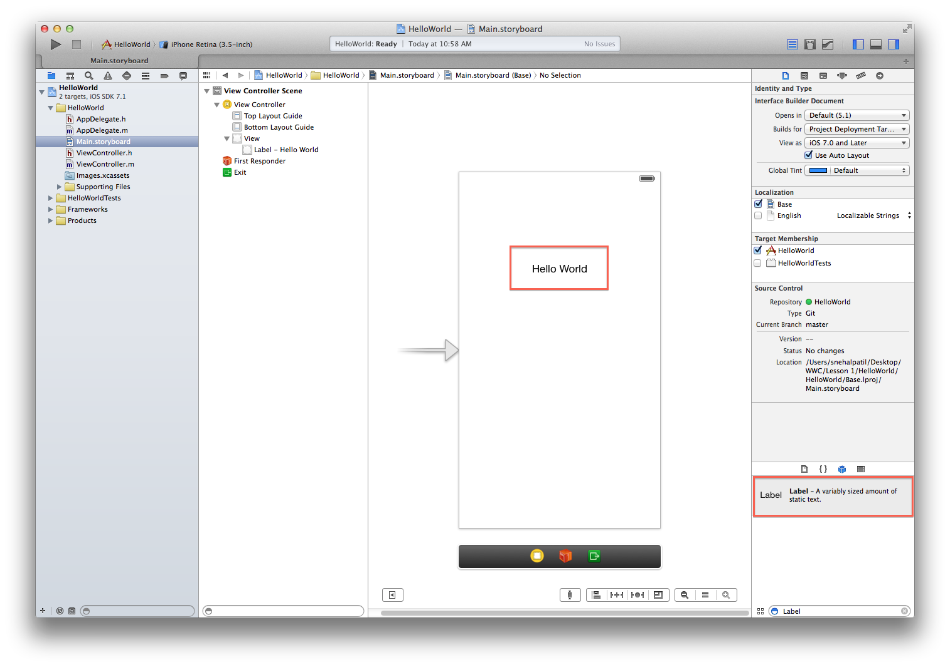
Add UILabel

Slide 26
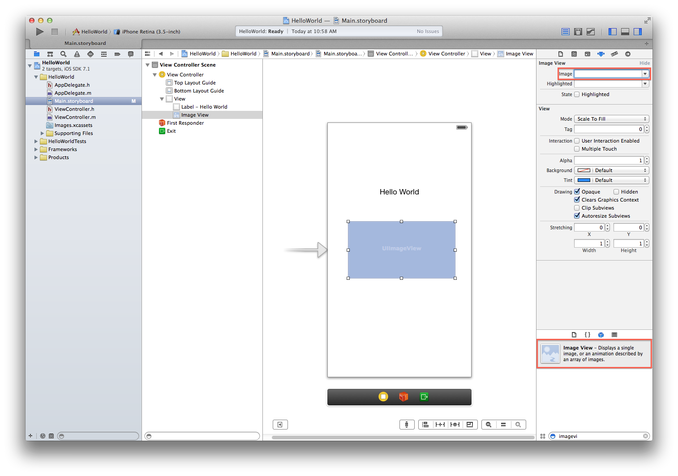
Add a UIImageView

Slide 27
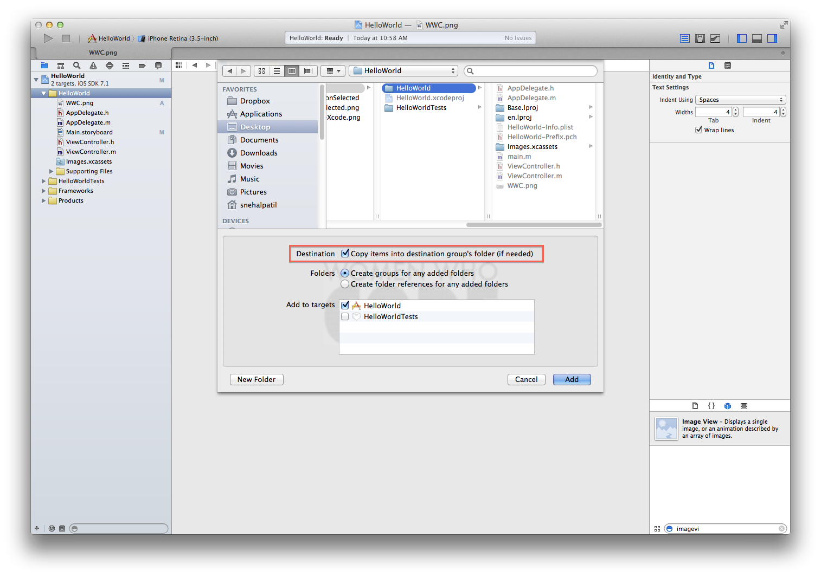
Add a Image to the project

Slide 28

Run the Project !

Slide 29
Yaay ! We have learned how to develop an iPhone app !
Kudos to all of you !
GitHub Link - https://github.com/WomenWhoCode/iOSBootcamp/tree/master/Lesson%201/HelloWorld

Slide 30
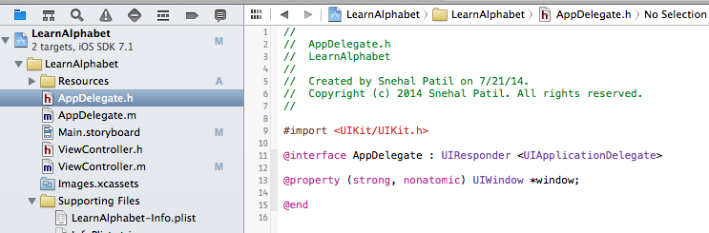
The Main Function
int main(int argc, char * argv[])
{
@autoreleasepool {
return UIApplicationMain(argc, argv, nil, NSStringFromClass([AppDelegate class]));
}
}

Slide 31
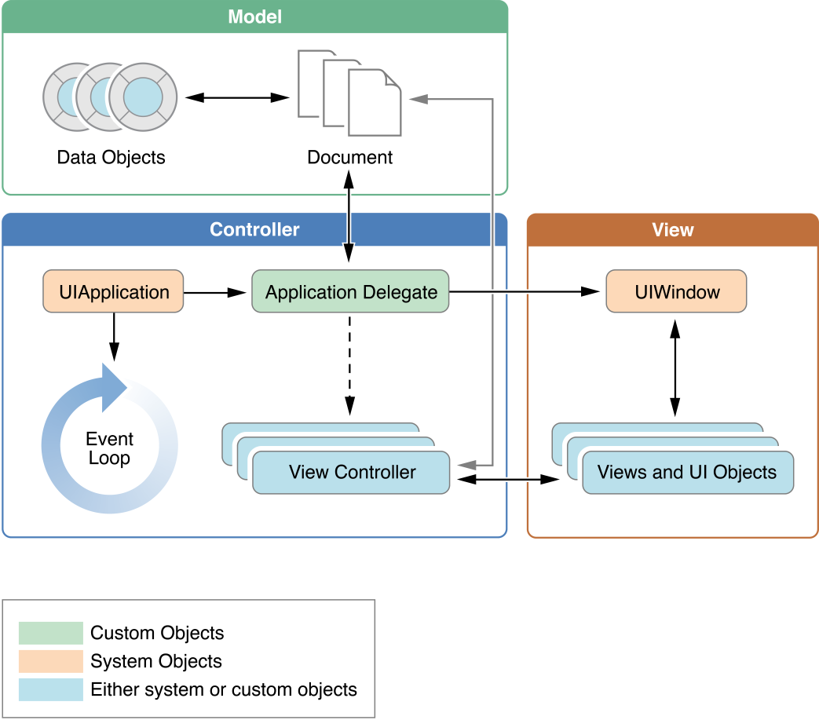
UIApplication and AppDelegate
Notes:
UIApplicationobject
The UIApplication object manages the event loop and other high-level app behaviors. It also reports key app transitions and some special events (such as incoming push notifications) to its delegate, which is a custom object you define. Use the UIApplication object as is—that is, without subclassing.
App delegateobject
The app delegate is the heart of your custom code. This object works in tandem with the UIApplication object to handle app initialization, state transitions, and many high-level app events. This object is also the only one guaranteed to be present in every app, so it is often used to set up the app’s initial data structures.

Slide 32
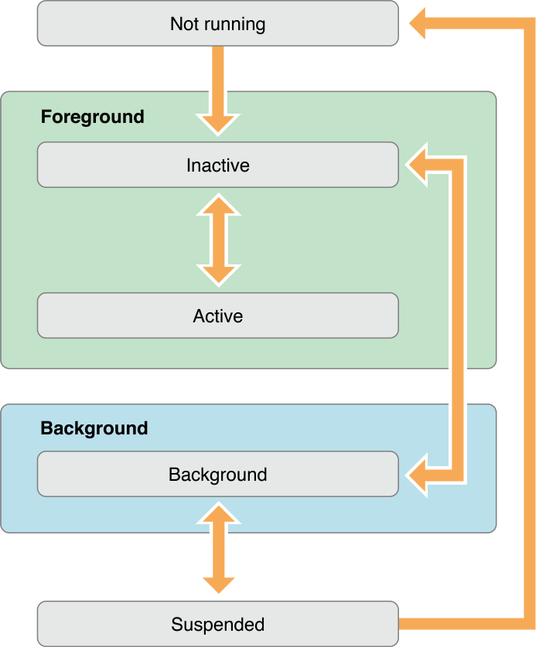
App States
Inactive
Active
Suspended
Background
Terminated

Slide 33
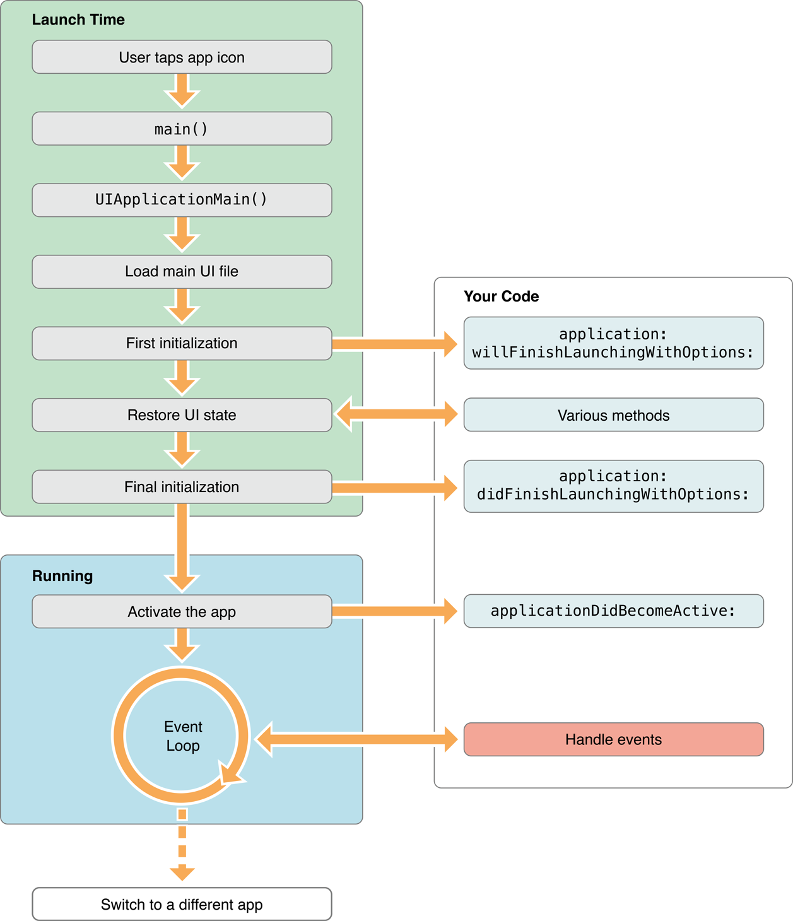
App Life Cycle

Slide 34
Learn Alphabet

Slide 35
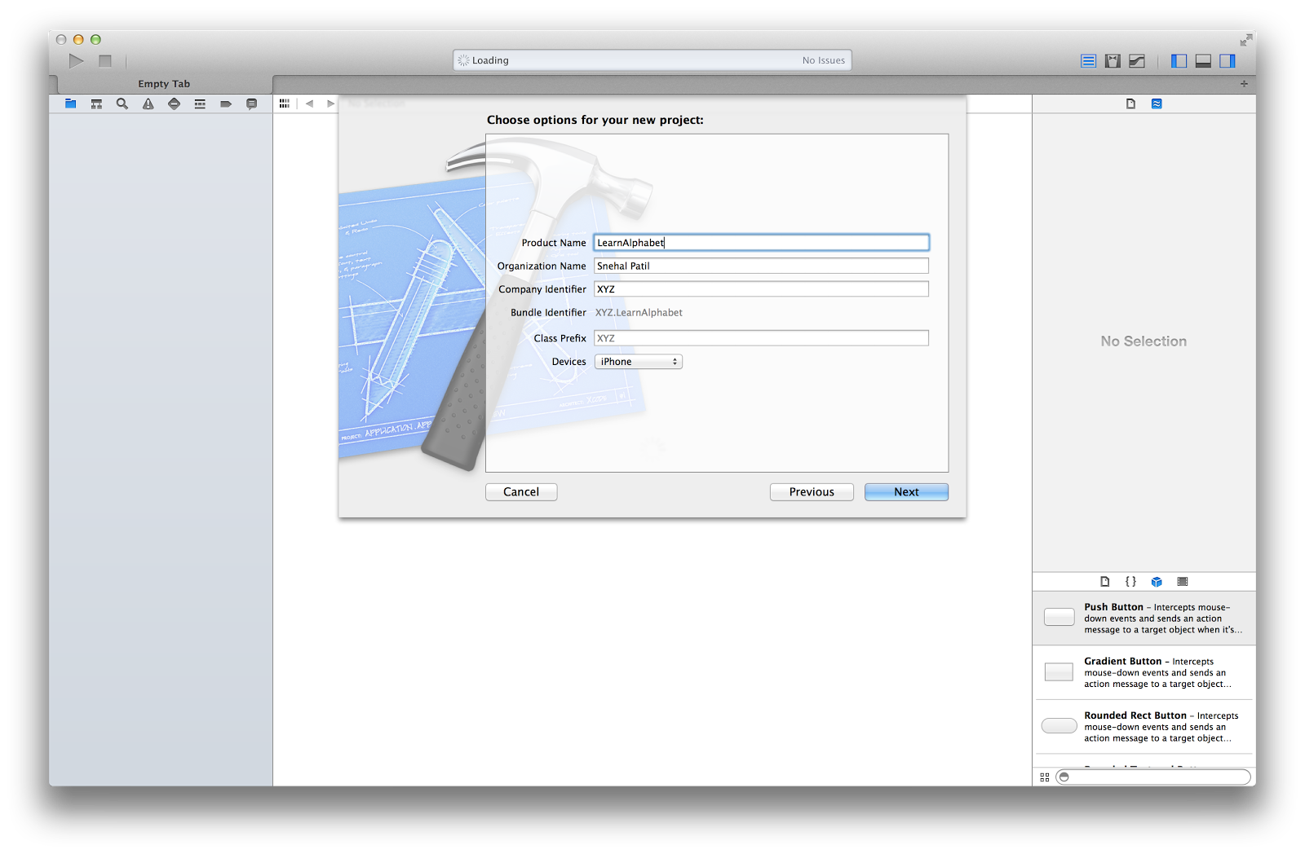
Create Learn Alphabet Project

Slide 36
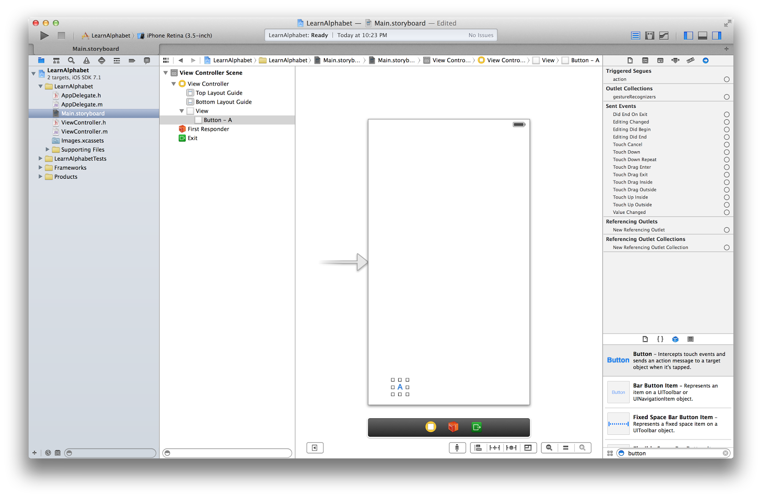
Add UIButton

Slide 37
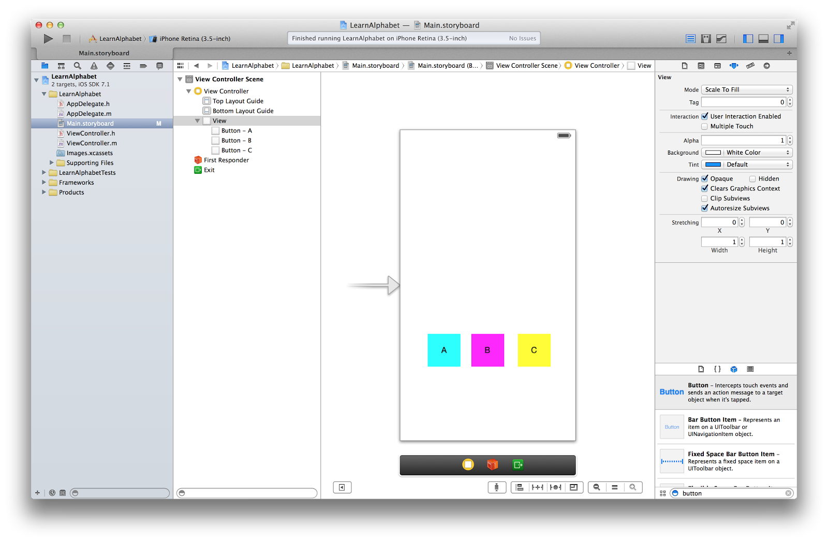
Add background color for buttons

Slide 38
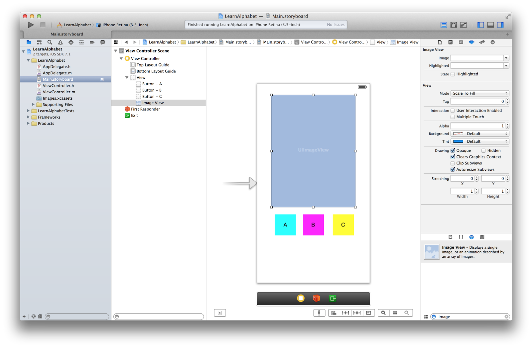
Add Imageview

Slide 39
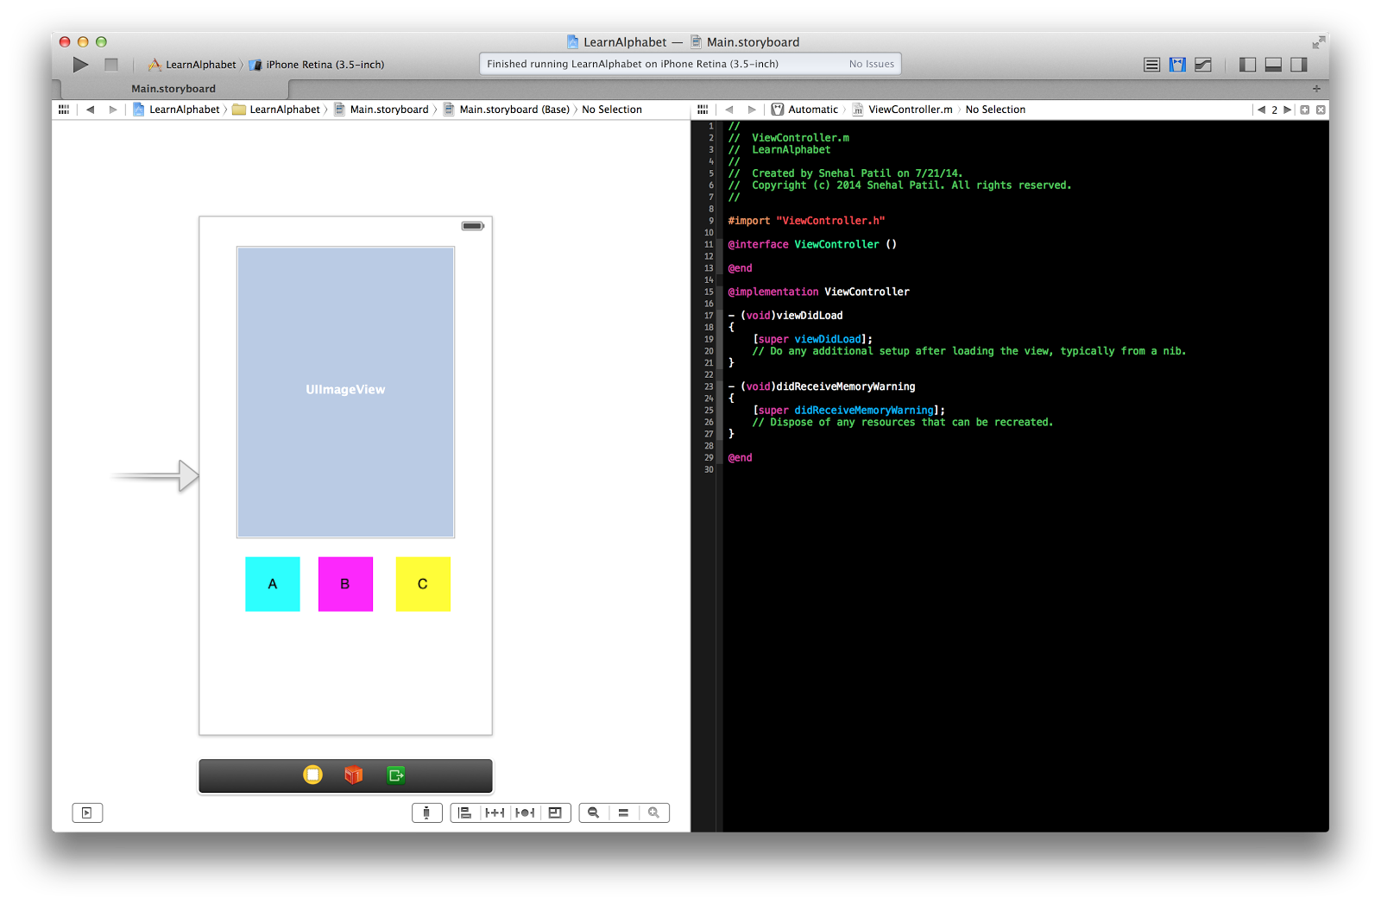
SplitView, ViewDidLoad, DidReceiveMemoryWarning

Slide 40
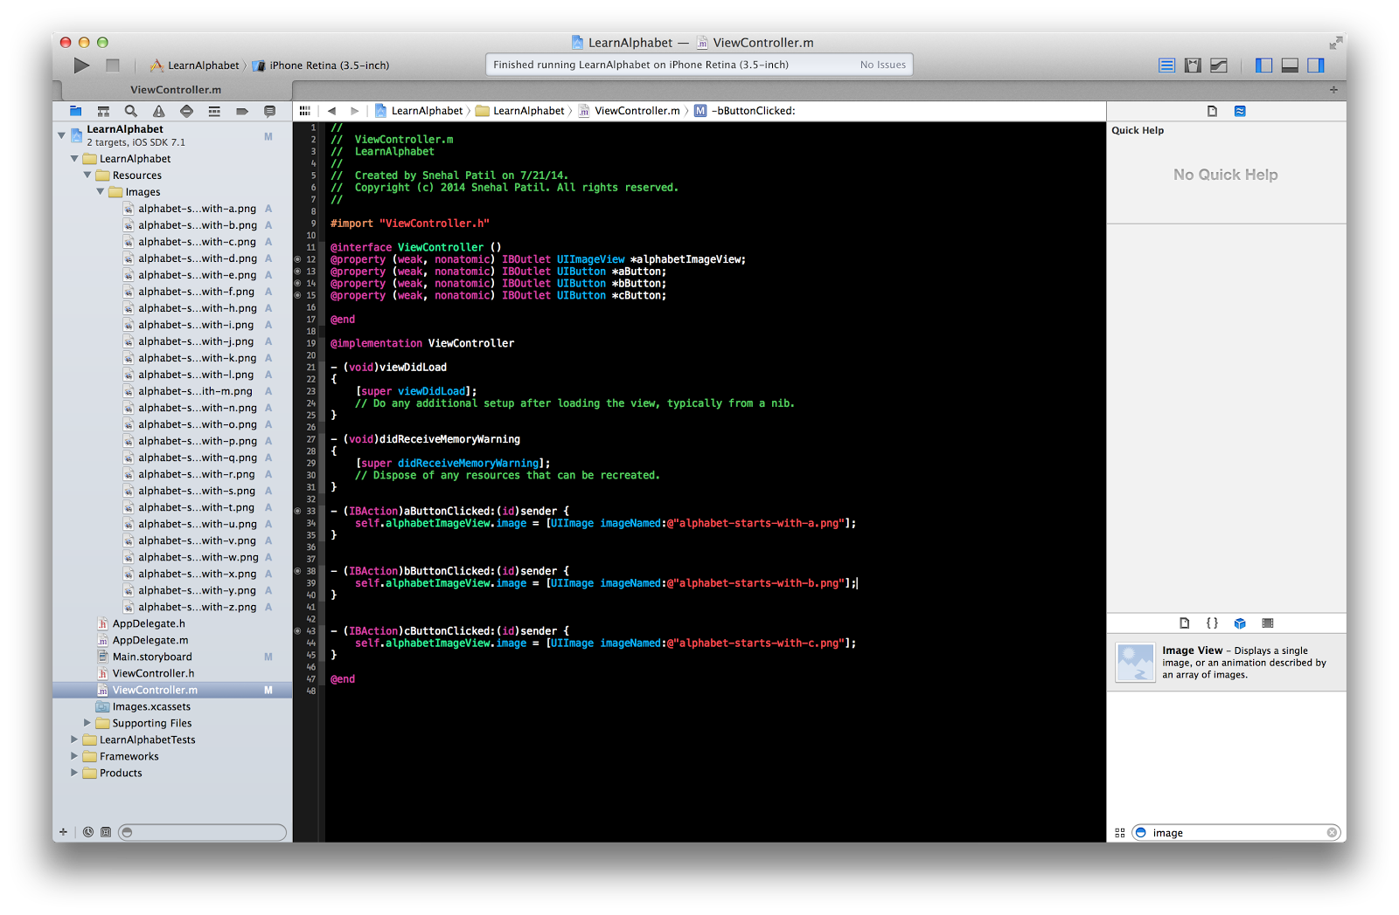
Connect Properties, IBAction and IBOutlets

Slide 41
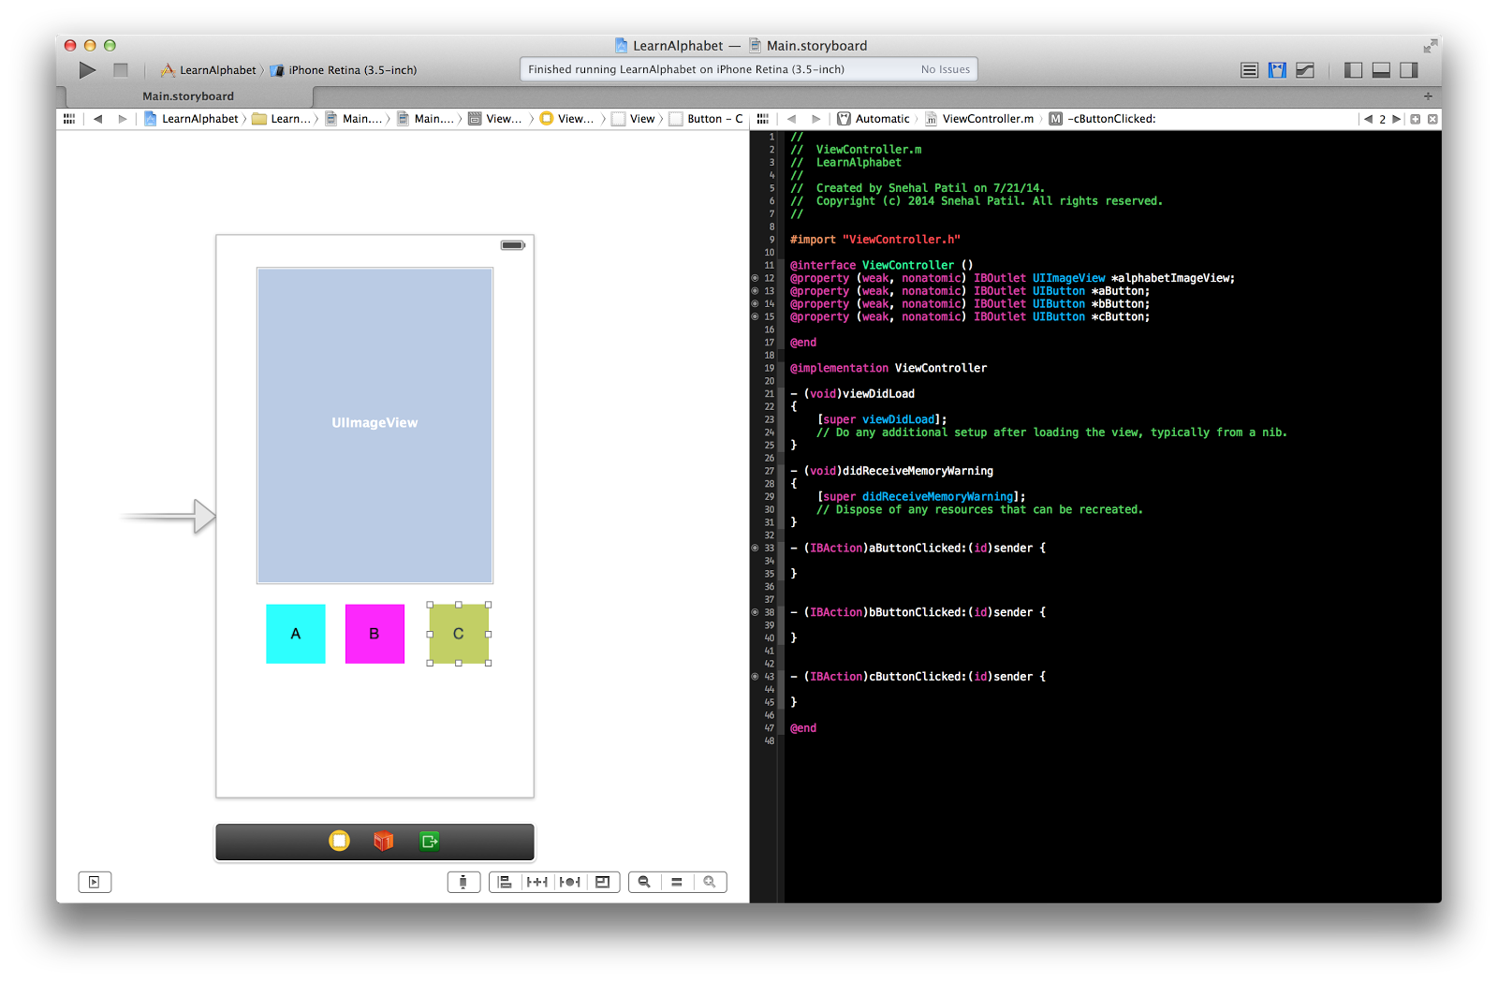
Add IBAction

Slide 42
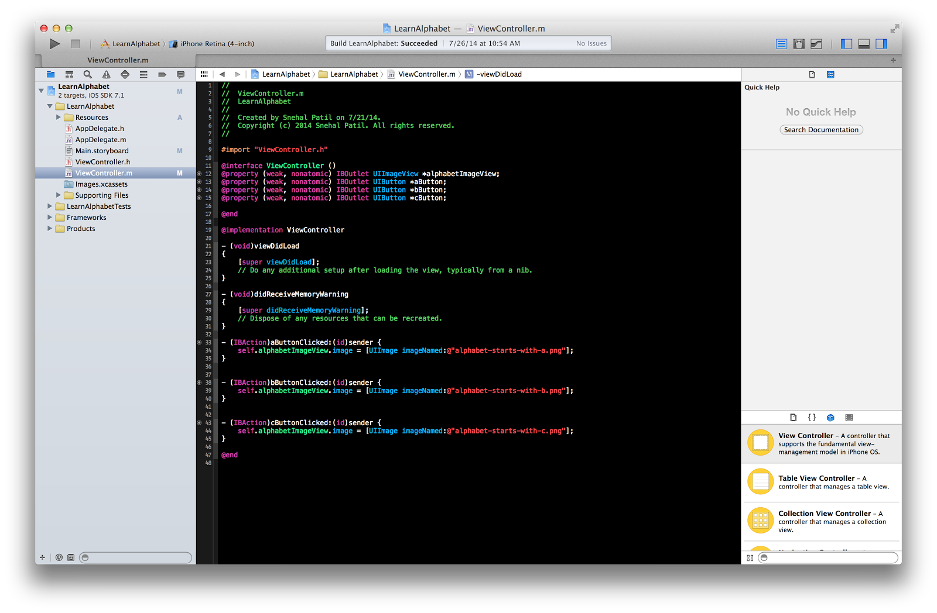
Change Image on button click

Slide 43
Git Link for Learn Alphabet
https://github.com/WomenWhoCode/iOSBootcamp/tree/master/Lesson%201/LearnAlphabet

Slide 44
Questions !

Slide 45
Feedback

